Slide 1
10 AI Predictions For 2026
Week of April 27th
Elias Hord

Slide 2
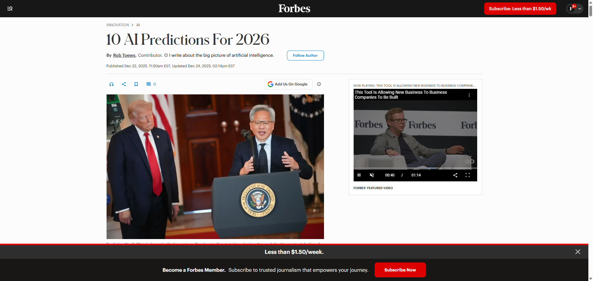
General Information
Article Publication: December 22th, 2025
https://www.forbes.com/sites/robtoews/2025/12/22/10-ai-predictions-for-2026/

Slide 3
Main Findings and Arguments
Major industry shifts and competition
AI companies will face financial pressure, with moves like IPOs (e.g., Anthropic) and continued private funding battles.
The U.S.–China AI rivalry will intensify, especially in semiconductor development and supply chains.
Shift in how AI is built and used
Spending will move from training models to running (inference) and deploying them at scale.
Smaller, more efficient models and techniques like distillation will become dominant over massive models.
Rise of AI agents and automation
AI systems will evolve into “digital workers” or agent teams capable of completing complex workflows autonomously.
Hardware, energy, and infrastructure pressures
AI demand will drive custom chip development and strain energy systems, potentially accelerating alternative energy investments.
Expansion into robotics and physical-world AI
Significant progress in humanoid robots and warehouse automation is expected.
Data and regulation trends
Growth of synthetic data for training AI systems
Diverging regulations (stricter in Europe, lighter in the U.S.)
Cultural and technical shifts
Less focus on abstract ideas like AGI; more focus on practical deployment and ROI
Increased importance of trust, verification, and human-authored content

Slide 4
Broader Implications for Society
1. Transformation of Work
AI agents will automate routine and even moderately complex tasks, shifting humans into oversight roles.
New jobs will focus on managing, auditing, and coordinating AI systems, not just using them.
2. Economic Restructuring
High infrastructure costs (chips, energy, data centers) will concentrate power among large tech firms and nations.
At the same time, smaller, efficient models may democratize access to AI tools.
3. Geopolitical Tension
The U.S.–China competition in chips and AI could reshape global alliances and trade systems.
4. Trust and Information Integrity
With synthetic data and AI-generated content increasing, verifiable human content and trust mechanisms become critical.
Potential integration with technologies like blockchain for accountability is hinted.
5. Everyday Life Integration
AI will become embedded in daily systems (shopping, communication, services), often acting on behalf of users, not just assisting them.

Slide 5
Relevance or Potential Influence on the Construction Industry
1. Automation of Project Management
AI agents could handle:
Scheduling
Cost estimation
Procurement coordination
This reduces administrative workload and improves efficiency.
2. Labor and Workforce Shifts
Increased automation may:
Reduce demand for some administrative roles
Increase demand for AI-literate construction managers and engineers
3. Robotics on Job Sites
Advances in robotics could lead to:
Automated material handling
Robotic construction tasks (bricklaying, inspections)
Especially relevant for labor shortages and safety improvements
4. Smarter Infrastructure and Equipment
AI-driven systems could optimize:
Equipment usage
Site logistics
Predictive maintenance

Slide 6
Relevance or Potential Influence on the Construction Industry Cont.
5. Supply Chain and Materials Optimization
AI can improve:
Procurement efficiency
Cost forecasting
Risk management (delays, shortages)
6. Increased Importance of Data and Digital Twins
With AI relying heavily on data:
Construction firms will need better data collection, modeling (BIM), and integration systems
7. Energy and Infrastructure Demand
AI-driven energy demand (data centers, power infrastructure) may create new construction opportunities:
Power plants
Data centers
Grid expansion projects

